Slide 1
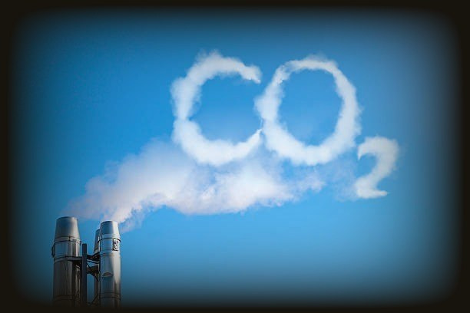




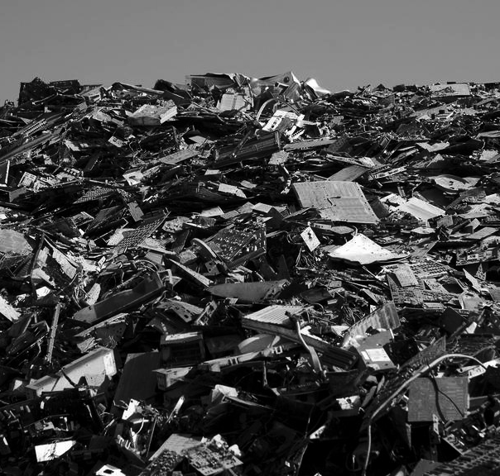

Carbon metrics
Coverage
Why are people with diamond shoes are bad for the environment?
Because they have a Big carbon footprint.

Slide 2
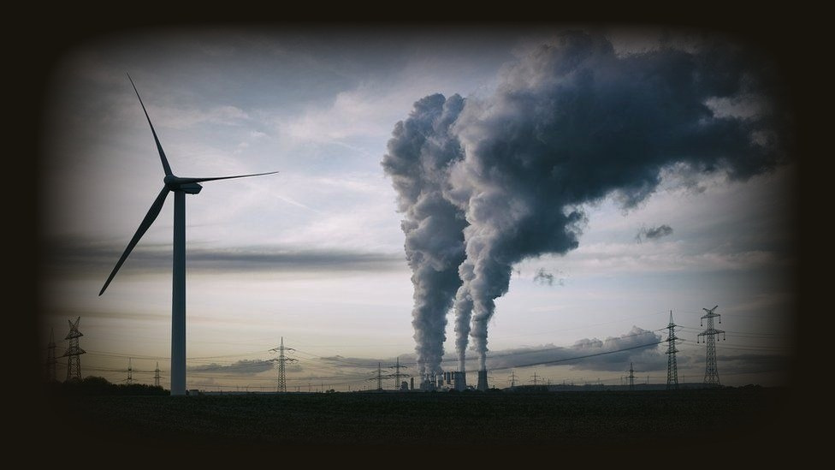
Table of contents
01
02
03
What IS Carbon metrics?
Five M’s
Coverage of carbon metrics
04
05
Emissions monitoring by different industry sectors.
framework for Green it metrics

Slide 3

Metrics
C
2
A carbon metric can be understood as a standard of measurement of GHG emissions. It is based on transparent, verifiable,traceable and reliable GHG accounting and assessment at all scales. Such standards are usually developed by a larger group of actors in which scientists as well as representatives of other interested parties are involved, including consumers and non-governmental organizations.

Slide 4
Five m’s of carbon metrics
Five “m”s of carbon metrics determine the current and the future state of a green organization.
1]Measure: this is the core “M” for the green policy. This provides the metrics for capturing the statistics.
2]Monitor: after measurement, we need to monitor the system for refining the policy.
3]Manage: we need to manage the measured and monitored information to improve the process.
4]Mitigate: reduce greenhouse gases by reducing the sources or increasing sink.
5]Monetize: convert the improvement into monetary values for the organization.

Slide 5
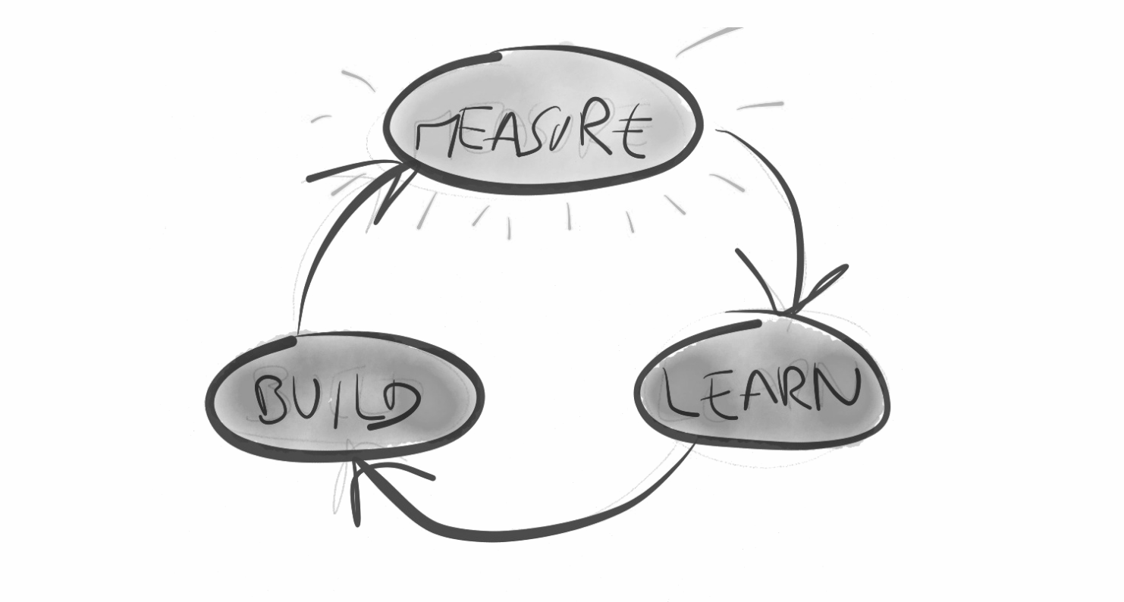
measure
It is the primary application of metrics which is to measure the emissions which can be achieved through a range of emission sensors, measurement platforms, monitoring and inventory systems, and inference methods.improved measurement and monitoring technologies and capabilities can help to identify and guide future opportunities for technology development. measurements can only succeed if these metrics are created and tested for their validity. Currently, in green it domain, very few metrics exist that are robust enough to be applied across the organization. Furthermore, units for these metrics are also not available in a unified and well-accepted manner.

Slide 6

M nitoring
IT’s crucial role in economic recovery is the key to unlocking the opportunity of Green growth and standardized metrics are required for the net CO2 reductions. Once the metrics are developed, they are used to monitor the performance of the organization from a carbon perspective. monitoring also implies continuous measurement using smart metering devices as well as ability to ascertain improvement. Standards to monitor and verify carbon emissions with reference to a baseline need to be defined in advance. Use of a reporting dashboard (Environmental Sustainability Dashboard) assists with the task of monitoring emissions and taking appropriate actions. Software systems need to be designed to ensure that environmental data collection is considered as a normal part of the business and that regular and frequent feedback is provided to the users.

Slide 7

mitigate
Mitigation is the action taken to reduce greenhouse gas emissions. It can be achieved by reducing their origin through the places from where they are sourced or by improving the ability of the organization to dissipate or sink the emissions. Mitigation strives for improvement in the process so as to result in permanent reduction in the emissions. after measuring carbon footprints using intelligent data collection and modeling technology, carbon emissions are mitigated through performance tracking of reduction targets and improved energy efficiency.

Slide 8

Manage
Taking the results of the measurement and monitoring process and determining from that data what should be done to improve the process. Managing emissions involves commitment to reduce business impact on climate change, auditing the emissions, making the target plan. The plan must be integrated in the business policies by reviewing the performance and encouraging carbon reducing policies.

Slide 9


M netization
Deals with converting the improvement of the organization over its carbon performance into monetary value such as through its marketing effort or on the stock exchange or through carbon trading.
-Developing strategies for energy use, combined with the widespread misconceptions about the energy system. Human resource of an organization essentially be informed and educated about energy.
-Continuous monitoring of automation and behavior change of the business can help to establish new standards and legal precedents to further mitigate the causes and effects of the greenhouse gas emissions from that business.
-Understanding the organization’s carbon liability and managing carbon reduction investments, renewable energy credits, and energy-efficient processes with clarity will help to decrease the intensity of carbon footprints.

Slide 10
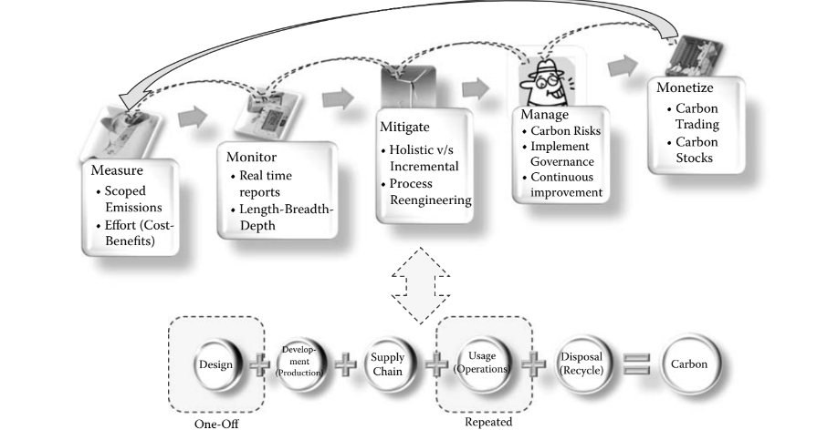
Coverage of carbon metrics

Slide 11
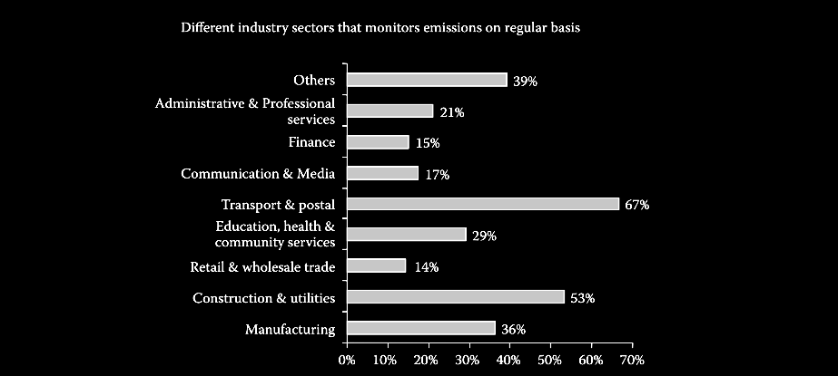
Emissions monitoring by different industry sectors.

Slide 12
Emissions monitoring by different industry sectors.
notice how, in terms of percentage importance to emissions monitoring, the transport industry gives very high importance (67%) to the measurement of carbon emissions, whereas financial services provide the least importance (15%) in terms of carbon measurements. this relative importance placed by the industry sectors is interestingly reflected in the actual results in terms of the emissions.

Slide 13
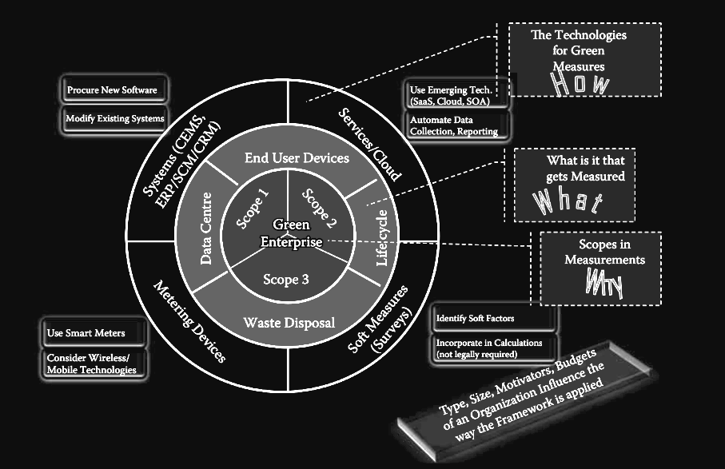
FRamework for green it metrics.

Slide 14
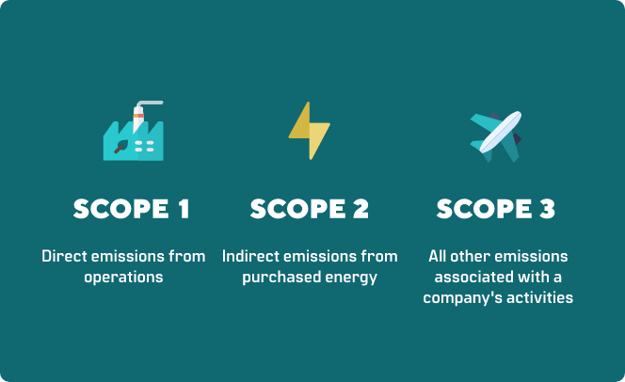
Scopes of green it metrics
the CO2e calculations, based on the National Greenhouse and Energy Reporting System
(NGERS), are required to b e divided into three diff erent categories, or scopes. these scopes of
emissions facilitate their calculations and reporting. these emissions are distinguished under
Scope 1, 2, and 3 emissions depending on their characteristics.

Slide 15
SCOPE 1: Direct GHG emissions
Direct GHG emissions occur from sources that are owned or controlled by the company, for example, emissions from combustion in owned or controlled boilers, furnaces, vehicles, etc.; emissions from chemical production in owned or controlled process equipment. Direct CO2 emissions from the combustion of biomass shall not be included in scope 1 but reported separately. GHG emissions not covered by the Kyoto Protocol, e.g. CFCs, NOx, etc. shall not be included in scope 1 but may be reported separately.
Scope 2: Electricity indirect GHG emissions
Scope 2 accounts for GHG emissions from the generation of purchased electricity consumed by a company. Purchased electricity is defined as electricity that is purchased or otherwise brought into the organizational boundary of the company. Scope 2 emissions physically occur at the facility where electricity is generated.
scope 3: Other indirect GHG emissions
atScope 3 is an optional reporting category that allows for the treatment of all other indirect emissions. Scope 3 emissions are a consequence of the activities of the company, but occur from sources not owned or controlled by the company. Some examples of scope 3 activities are extraction and production of purchased materials; transportation of purchased fuels; and use of products and services.

Slide 16


